Slide 1
‘The engineering entrepreneur,
Recreating public spaces empowerment

Slide 2
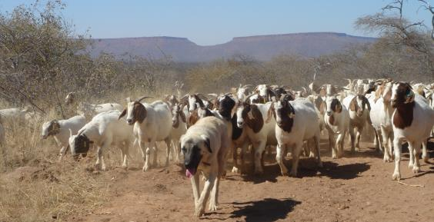
Subsistence man
Since the world is on a direct tradjectory of the
fundamental foundation of geographic longtitude the chemistry for methodologic productivity of the occipital poles forces and matter of earths where the generic adaptation with all things intended generic/hereditary methodology for creation lifeform mechanology, of the entitlement that surpass lifeline geneology doctorine of tradjectory priveledge of the inclusion to rectify the beauty of the creation statutory race and creed. Being fed from the will to survive/exsist through tuteledge to the exposure of the lifes directed purpose means ie. Commodite from construct of systematic occipital jurisprudence ecosystem . For the common good of work, work of the nature, mystic direction and magnitude share role in guidance and direction subsistence articulate of information ‘intelligence’ gametheory’ or folklore’ but emotional belonging to the exsistencial understanding of systems interaction of empire and capital at least exhibition of its millenia history manuscript productive developedment .through ecological system compliance. A consciousness of ethical practice and theory.The entitlement and priveledge of skills and trades . To build on this architectural design.

Slide 3
Subsistence Prophecy
Poetic benediction ‘horizon of provision manifestation, ‘providence of aboundant consumption stockpile, to translate convert to “empiric lifecycle ‘Ergronomic Infrastructure of economic social Finances/ Tendering traditional subsistence doctorination for revelations of empiric world allocation of market goods-services, known methodical harvest innovation, expansion institutional methodical machine productc /graphic tradjectory of capital reasources of dissident apocalypse revolution for orthodox outcomes of subsistence coincide with lexical substance and property’s of creation compliance with horizontal foundation definition.

Slide 4
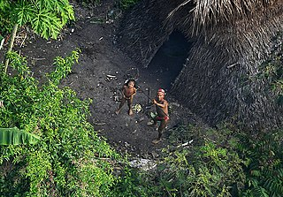
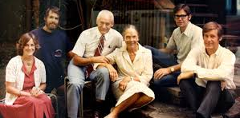

Empiric technology-lexical expansion the orthodox economy

Slide 5

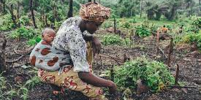
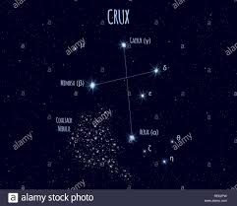
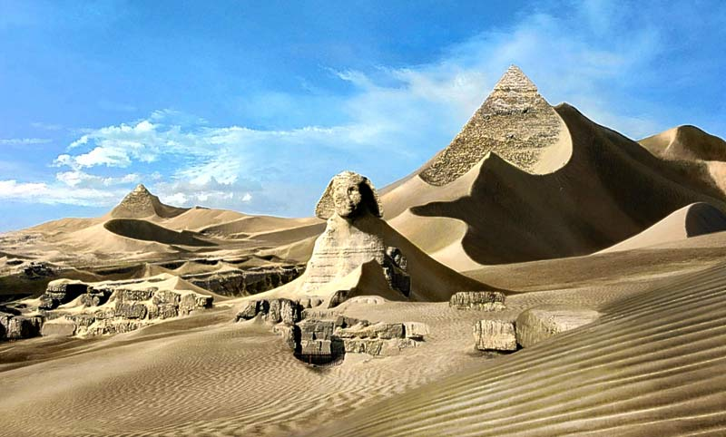


Slide 6
innovation
For the common good of work, work of the nature, mystic direction and magnitude share role in guidance and direction subsistence articulate of information ‘intelligence’ game’ or ‘emotion folk’ but emotional belonging to the exsistencial understanding of systems interaction of empire and capital at least exhibition of its millenia history manuscript productive developedment .through ecological system compliance. A consciousness of ethical practice and theory.The entitlement and priveledge of skills and trades . To build on this architectural design.

Slide 7
engineering
Psycological co-ordination {lexical} learning of intellectual subsistence information/intel {ossipital} world commonwealth-motherafrica-fatherland-son father holyghost, stocks wealth , subsistence polynomer. {Clerical} personelle attendance of values stewardship covenant hierarchy of authority. Equalibrium maintain selfsustainance, cosmicsnake, motor reflexes, biomechanics,underworld.

Slide 8
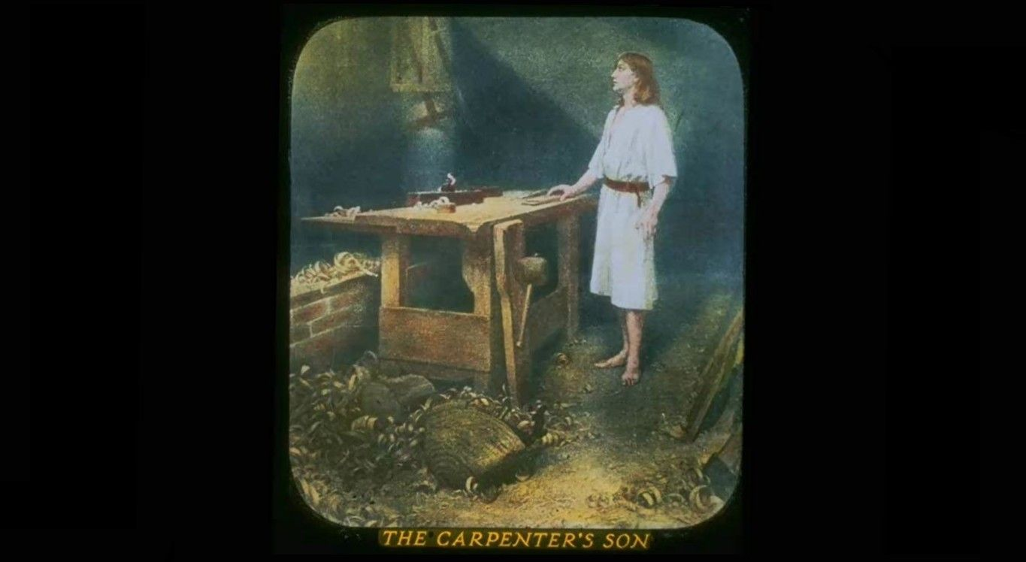
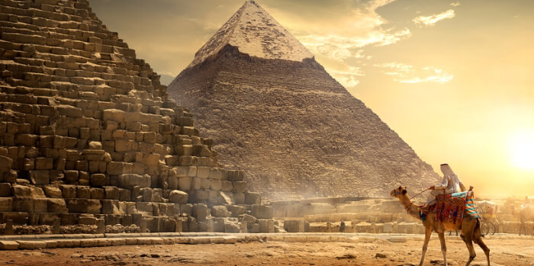
World prodigy
Lexical manuscript
commercial
industrial
Animated story scenario for tribunal methodology of community,capital from services infrastructure culture/control over industry’s of inhabitant field of endeavor
Evolving that lexical technology’s/innovation created the creation workspace station layer of empiric civilization ancient technological collective manuscript of construction innovative engineering
the indegenious stewardship diochamy to compile manuscripts on how they implemented the learning pedogogal stewardship professional apfredesiac exploiting trades of bible inheritance, creative art in field of endeavors.

Slide 9
Hommage milestone

Slide 10

Subsistence Polynomer

Slide 11
Marketing
Consultation for this product . Where the intuitive forces of the pedogogi influence the intuitive stratedgy of the commission to evaluate and verify celestial destiny of alignment with corporate {apostalic} numeric data information/intel life creation ‘hierarchy’halo’ architecture canonical atmosphere guidance to orthodox infrastructure of mystic tradition, evolution tradjectory to tradition
Lexical collaboration on innovation lexical creation alternatives than apostle. Tendering the protocols of the governance

Slide 12
World and business of one
To pass on the educated disposition of scholar professional which is proven to remedy society egronomic infrastructure , A belief in our elder wisdom of ancient heritage to pass on and instill the survival characteristics and methodology of righteous men ‘to carry-out honorable intuitive consciousness of life geneologic growth ideology, the survival-exsistence ‘tuteledge’ via ‘Anthropology concept’, empiric capitalism’Polynomer cultural-materialism goods-services Domestic, Commercial,Industrial. Entrepreneur/visionary guided enterprise endeavors of scripture. ethos,pathos,logos ‘ideology of the pseudoscience-apfredesiac’ chronicles/chronology, harvesting materialism of the genological melting pot of creation geology. Stratedgy to align Gametheory ‘architecture’of life ‘enterprise’ goods/services, fundamental foundation of orthodox learning.

Slide 13
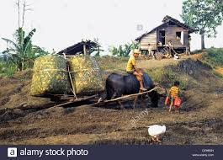
I.P Ordinance ‘innovative revolution of intellectual world engineering
I.P Ordinance ‘innovative revolution of intellectual world engineering
Characteristic profiles of the covenant , ‘the geneologic inheritance to the statutory methodology of lexical millenia ‘man,world and animal allocated reaching high into life diochamy reflecting of the competent and selfsustaining ecological creation, ‘harmony humility in affairs with life and system cycles.

Slide 14
Union delegate christ

Slide 15
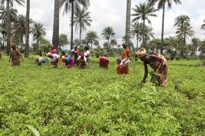
Subsistence theology
All social ecology initiatives that reflect on economic methodology, services that define the financial and economic characteristics of the covenant yielding vertical subsistence persona of product quality’s,values,property’s the characteristic profiles, ‘vocation skillset’ of geographic stockpile of gnp variable-factor.

Slide 16
Urban social union

Slide 17
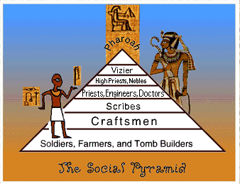
Enterprise architect
As a leadership of the”Urban civilization’ collective subsistence archeive ‘working towards harvesting ergronomic infrastructure efficiency, ‘ creating and implementing the human purpose in topological ecology ‘anthropologic design’ engineering orientation towards, cosmic lifesystem.

Slide 18
Binary building blocks of structural form
Mystic mechanology of the fundamental-foundation, concrete jungle anthropic ethics, creation orthodox calculus alignment of logistics, mechanology to productive field of endeavors , design disambiguation natural order ,human right ,modern efficiency ‘construction binary building blocks creation tuteledge of adapting subsistence mechanology the temperol lifeform; intuition equilibrium, cognitive consciousness, ‘life building art of life vocations’, field of life endeavors ‘natural impimentation of creation nessesity/essentials eco system.

Slide 19
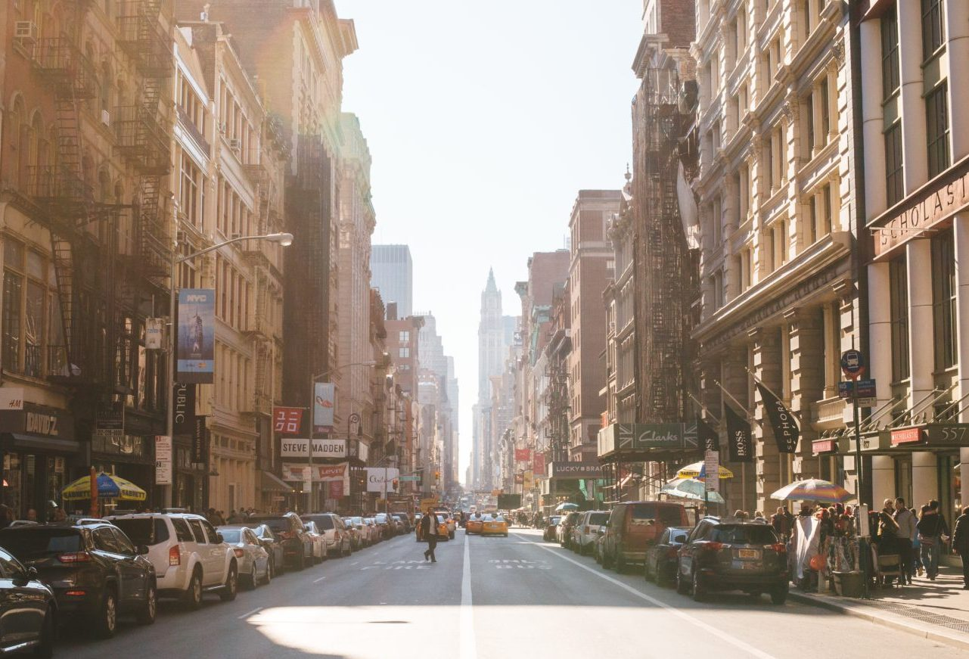
Buisness plannar architecture
From the geographic ‘evolution subsistence co-efficient, ‘to it’s traditional learning creation iteractive mentoring’ are it’s preceptive capital of subsistence “plannar” envision intuitive future from basic nessesity’s to innovative planning and preparing to expand on capacity of enterprise subsistence theology. Concrete jungle ‘polynomer’ of ‘empiric subsistence enterprise.

Slide 20
Open governance of ‘innovative technology’ to demonstrate ‘precision guidance, “plannar” for “graphic” holyland as a apfredesiac of services protocol embracing the magnitude of creation aboundance and fulfillment, to broker/testament to balance industry market economic essentials/nessesity’s of envisioning “creation unity” social and economic gains in enviroinment managedment, ‘{Hr} ,{Nr} conservation/preservation.
Product for “newcity” following subsistence three step mechanology for best-practices 21st century 1800 democratic call to action world prodigy in 3 stage concept.

Slide 21
Race of humanity
Authentic creation organology survival/exsistence skillset, tuteledge, methodology, ‘mapping dwellings’ of creation architecture, intuitive architecture consciousness of environment physics and interactive diversity of lifesystem deity, ‘intelligence enable to define the ”process dvelopedment and growth stages” of life career tradjectory, Anthropology concept. An up close and personal transcendental reactory chain with life ‘occipital’ {inclusion} logical move forward, sequencial-genes’ chronologically synchronizing to ‘occipital’ advanced more complex completeness of a multi-dimensional destiny measured and evaluated through brotherhood individualism effort ‘committed to enterprise solution outcome. Peers evaluations

Slide 22
Polynomer technology
Creating a ‘skit’ a poetic, theatrical, creative developedment of creation subsistence productivity of ‘canonical polynomer’ i.p of complex geographic natural prodigy ‘geometrical natural Anthropological implimentations ecological economic organology of monad adaptivity to statutory lifecycle

Slide 23
Proffesional
Internal pyramidology for jurisprudence architecture mentorship of creation genealogical censuses congregation ‘implementation of creation buildinglocks binary probable destiny, form of creation geneology generic/hereditary ideology, drivin impetus of metabolic millenia.

Slide 24
Polynomer Tardy
The opposite of tardy is quick, or prompt to understand, think, or learn; intelligent. Hence, Option A is correct. Among the rest of the options, enthusiastic means having or showing intense and eager enjoyment, interest, or approval/pedogogal, progressive means favouring social reform.
“Subsistence productivity” harvesting intelligent patentpend 3 step methodology of processes operation ‘chronicles of exsistencial organology earth wind fire ethos,pathos,logos of creation growth mechanology, {pope} inherited geneology of subsistence unified doctorination of harvesting collective layered growth processes Industrial engineering of collective materials adaptation practices of lifecycle `in unison with millenia metabolic creation logistic building blocks. Logistics of carpentry plumming vocations of life.

Slide 25
Exsistencial organology

Slide 26

The brotherhood and feudal society
The primary creeds of an entrepreneur/engineer.
Engineer/entrepreneur duties and responsibilities
Making plans using detailed drawings.
Preparing estimates and budgets.
Creating accurate project specifications.
Designing engineering experiments.
Creating technical reports for community and enterprise/government.
Completing regulatory documents concerning construction analysis construction design and architecture safety issues.

Slide 27
Our solution
To bring forwarth these trades of traditional world , to embrace the statistical civil society ‘credentials’ governance based on ergronomic tuteledge, ‘the “circular” orientation of biological lifeform creation {intuitive consciousness} productivity. Our team envisions the guidance liturgic policy’s of creations apfredesiac reasources platform, for the collective reasources of human engineering capital, intellectual-property. Productive ecosystem variable as a whole.

Slide 28
To restore liberty and equality, mankind eliminate both private property and government from curricular exercises and practices of societal clerical policy’s. Communities would then create their own "cooperatives," ‘congregations which would exchange goods and services among themselves. Like the liberals, socialists believed that men and society could be improved, and that the application of logistic and traditional principles of government and society could create a world in which people enjoyed liberty and equality. orientation and materialism Conservation/preservation movement - pseudoscience apfredesiac concluded that vision of vertical and horizontal of balanced evolution millenia and monad.

Slide 29
and priveledge of skills and trades . To build on this architectural design.
We can implement the complex, multi- dimensional stratedgys of this Enterprise architecture to laminate enterprise r&d, Infrastructure to solve creation, ethics stratedgy, and most proficient alignment of A.I capable horizon realitys, laminate varification of truths to define explicint commercial occipital horizon; industrial, commercial,domestic, and define stratedgic control of the statutory (iso) policys of 5G network satellite horizon to enlightened conveyors of literary creation horizon of lifes legendary, extensive compatible network operatores as are reporter, analyst, journalists, of christian enterprise intel/informations on socialethic (occipital) networks employing virtual reality through statutory unicorn extensive to all endeavor for offering or receptive services of the law in kingdom. Company.
With the information on the aspostles we could implicate an upperhand for the versatility and control world and prophecy for time has mend the versatility in the means of this work and its capability. As corporate sector systems ANALYSTS the apostolic union demomnstrates its methodical ideology of life, as it bears brand in the culture of its patented methodical planning application implemented on the virtues and truth for platform of ’natural design Implimentation into conflict with many theory philosophy of this sort message of message.

Slide 30

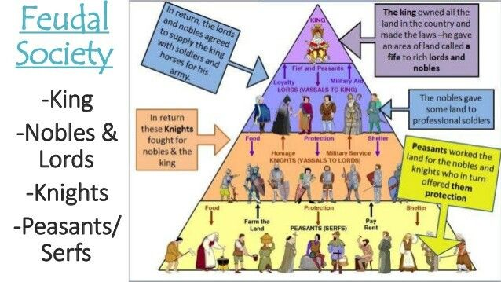
Circular Economics -Ergronomic orders

Slide 31
Economic philosiphy
We iterated the professional manuscripts to definen epic diversity of creation ‘clerical’ ergronomic i.p creation graphic for intellectual/emotional pedogogal scripture’ translating diochamy of congregation wisdom, reflecting secret ergronomic governance manuscript of millenia professional leadership, ‘community longevity.
Tardy ‘professional services, to analyze and cite always rebuilding on policy’s construct of professional organization to fortify purpose of enterprise life system and foodchain ecosystem. Both working towards implying on the clerical resasources ‘aligned and directed’ to creation congregation’ to grow with the betterment of ‘life’ innovative reasearch and developedment.

Slide 32
Rituals of lineage
Since the world is on a direct tradjectory of the fundamental foundation of geographic longtitude the chemistry for methodologic productivity of the occipital poles forces and matter of earths,wind and fire where the magnetic/biomechanical adaptation with creation and all things intended via intuitive generic/hereditary methodology for creation lifeform chronolgical mechanology, of the entitlement that surpass lifeline geneology doctorine of art tradjectory, ‘picturesque priveledge of the inclusion to rectify the beauty of the creation statutory race and creed. Being fed from the will to survive/exsist through tuteledge to the exposure of the lifes directed purpose means ie. Commodite from construct of systematic occipital jurisprudence ecosystem . For the common good of work, work of the nature, mystic direction and magnitude share role in guidance and direction articulate of information gametheory or folklore but emotional belonging to the exsistencial understanding of systems interation of empire and capital humility of selfsustainance of its millenia history manuscript productive developedment .through professional compliance. An exsistencial theory of ethical practice.The entitlement and priveledge of skills and trades . To build on this architectural design.

Slide 33
Capitalism by its very nature required the exploitation and de-humanization of the working class majority.
Human progress therefore required that the working class organize, overthrow the capitalists and their state, and establish a socialist form of government with public control over all productive property.
this would create "real" democracy—social democracy based upon the ideal of social rights and social equality.
under socialism and the "dictatorship of the working class," social classes and class conflict would eventually disappear
as a result, government ( considered as a weapon of class rule)

Slide 34
Socialism social buisness
Concious envisioned individuals render the celestial lifepath to envision and exploit their tales the messages of their transcendental missions as proffesionals of inclusion to world enterprise ‘inspired of experiences and truths co-ordinated by the authority of god which led to the ‘theosiphic creation’ cosmology manuscripts of process, developedment and growth.

Slide 35

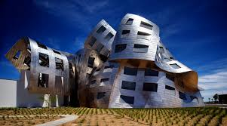
Subsistence mechanology
Garbage recycling order chaos disorder creation lineage horizon agriculture rows of growth developedment orientation, lifecycle degredation .

